Slide 1
Data Visualization in R
Jenn Schilling
April 12, 2021

Slide 2

Hello!
Jenn Schilling
Senior Data Analyst, University Analytics & Institutional Research, University of Arizona
Adjunct Faculty, System Design Thinking, College for Creative Studies
Notes:
Welcome to Day 1 of the Data Visualization in R webinar. I’m Jenn Schilling, and I am excited to be with you today. I am a senior data analyst at the University of Arizona, and an adjunct faculty member at the College for Creative Studies where I teach graduate classes on data visualization.

Slide 3
Day 1 Agenda
Why is data visualization important?
Best practices in data visualization
Data visualization in R
R setup
How to make a scatterplot in R
How to make a line graph in R
Questions
Notes:
Today we will begin by briefly covering some data visualization concepts and best practices. Then we will dive into data visualization in R, getting set up, and making two different types of plots.

Slide 4
Learning Outcomes
Explain how the grammar of graphics works in R
Create three different plots in R
Add titles and labels to a plot in R
Change the formatting of a plot in R
Notes:
The learning outcomes of this webinar are that participants will be able to explain how the grammar of graphics works in R, create three different plots in R, add titles and labels to a plot in R, and change the formatting of a plot in R.

Slide 5
Why visualize data?
Gain understanding
Show patterns
Engage viewer
Convince viewer
Tell a story
Notes:
There are many excellent resources on data visualization, including some webinars by AIR. However, I wanted to begin by covering some basic principles of data visualization. First of all, why do we visualize data? Some reasons may be to gain understanding of data, to show patterns, to engage or convince the viewer of something, or to tell a story. But, we need to be careful with patterns because we can easily jump to conclusions and see causality when it is not there. And we need to be careful with storytelling too because we must ensure that we are accurately and truthfully representing the data (plus we have a tendency to attach stories to patterns that we see that may not be accurate). So, to ensure that we are representing data truthfully and accurately, it’s important to explore the data first and then craft the message rather than the other way around.

Slide 6
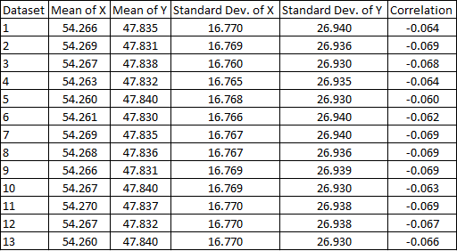
Datasets of (x, y) coordinate pairs
Notes:
Here’s some more motivation for visualizing data. I have 13 datasets of (x, y) coordinate pairs. In this table, I have summarized the data with means, standard deviations, and correlations. From this table, it appears that all 13 datasets are quite similar.

Slide 7
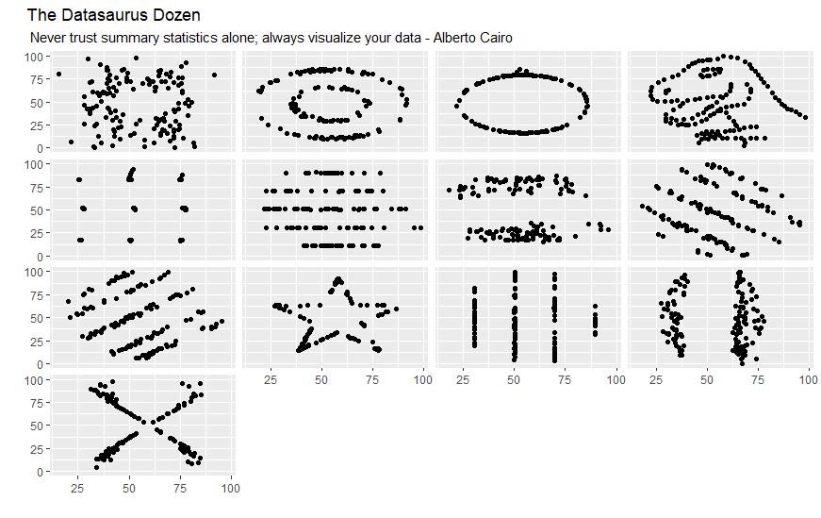
Datasets Visualized
Notes:
However, when we visualize those 13 datasets, we can see that they are all widely different from one another. One even makes a dinosaur! These datasets were created by Alberto Cairo to provide motivation to visualize data.

Slide 8
Best Practices in Data Visualization
“A good visualization is:
reliable information,
visually encoded so relevant patterns become noticeable,
organized in a way that enables at least some exploration, when it’s appropriate,
and presented in an attractive manner, but always remembering that honesty, clarity, and depth come first.”
(Cairo, 2016, p. 12)
Notes:
So, what makes an effective data visualization?
This is not a simple question with a straightforward answer, but broadly speaking, it is important to be honest and truthful and accurately represent the data while keeping in mind the audience, the goal to inform the audience, and the principles around how humans perceive visual elements. This quote comes from Cairo’s book The Truthful Art.
Cairo, A. (2016). The truthful art: Data, charts, and maps for communication. New Riders

Slide 9
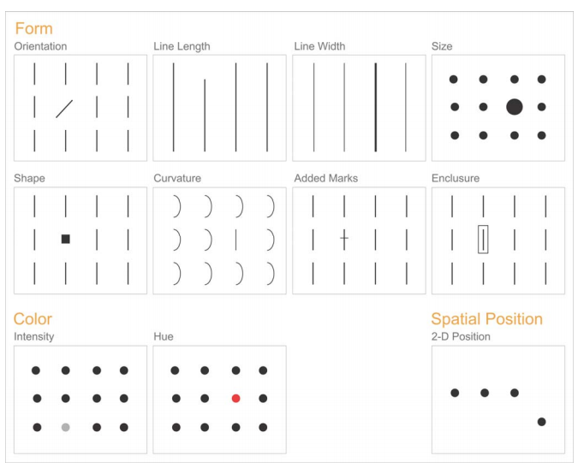
Best Practices in Data Visualization
(Few, 2004, p. 5)
Notes:
One best practice in data visualization is to keep in mind the preattentive attributes. These attributes are represented in the visual above, which is from Stephen Few’s paper on Visual Perception. Preattentive attributes are interpreted without conscious awareness. The preattentive attributes are ways to encode data that will easily allow the viewer to pick things out or compare them.
Source: https://www.perceptualedge.com/articles/ie/visual_perception.pdf

Slide 10
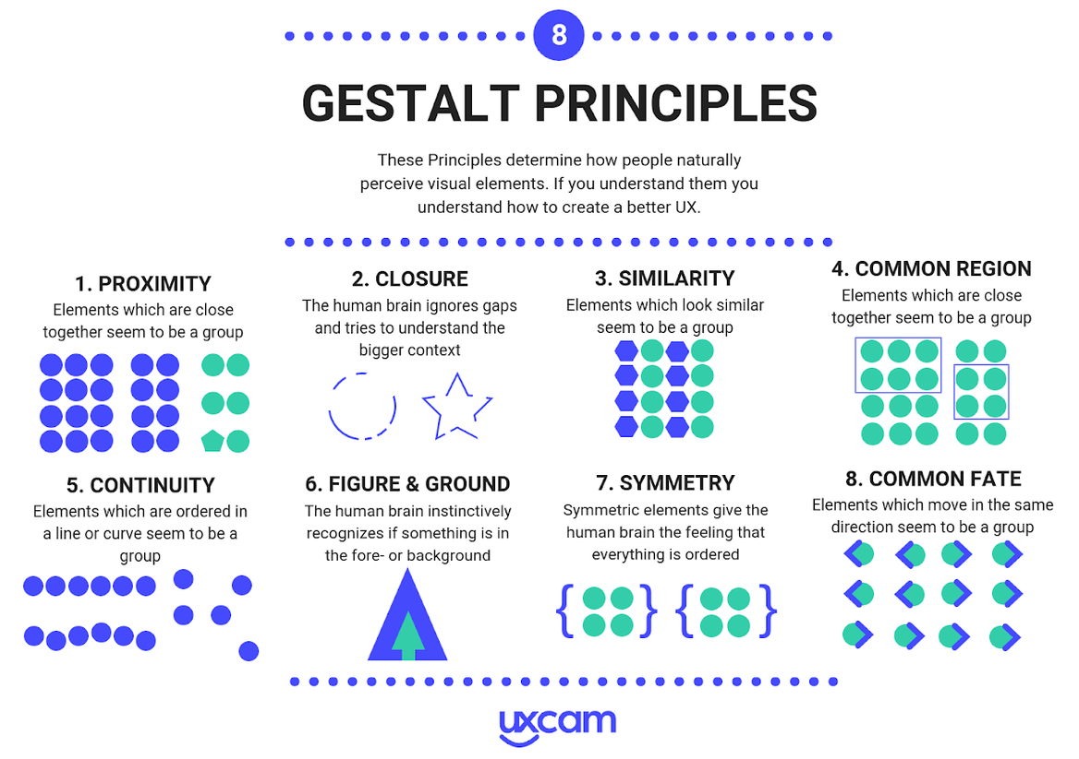
Best Practices in Data Visualization
(Bufe, 2019)
Notes:
Gestalt Principles are also important and useful for helping viewers interpret data visualizations. These principles are used in design, but can also be used in data visualization, particularly the principles of proximity, similarity, and continuity.
Source: https://uxcam.com/blog/gestalt-principles/

Slide 11
Best Practices of Data Visualization
The Five Qualities of Great Visualizations:
Truthful
Functional
Beautiful
Insightful
Enlightening
(Cairo, 2016, p. 45)
Notes:
Finally, Cairo lists five qualities of great data visualizations in his book The Truthful Art; data visualizations should be truthful, functional, beautiful, insightful, and enlightening. These are qualities we can keep in mind when designing data visualizations, and these are things that I think ggplot2 and R make easy to do once you get the hang of the process. The graphs we will look at in this webinar are not particularly beautiful or enlightening as they have been made with the intention more of developing ggplot2 knowledge, but hopefully you will find them truthful, functional, and insightful to how the ggplot2 process works.
Cairo, A. (2016). The truthful art: Data, charts, and maps for communication. New Riders

Slide 12
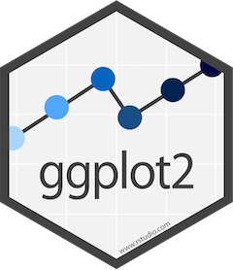
Data Visualization in R
Library: ggplot2
Robust
Iterative
Flexible
Functional
Notes:
To build data visualizations in R, we will use the ggplot2 package, which is part of the tidyverse collection of packages. I really like ggplot2 and creating data visualizations in R because I find it to be a robust process that is easy to iterate on. It is flexible and it is certainly very functional.

Slide 13
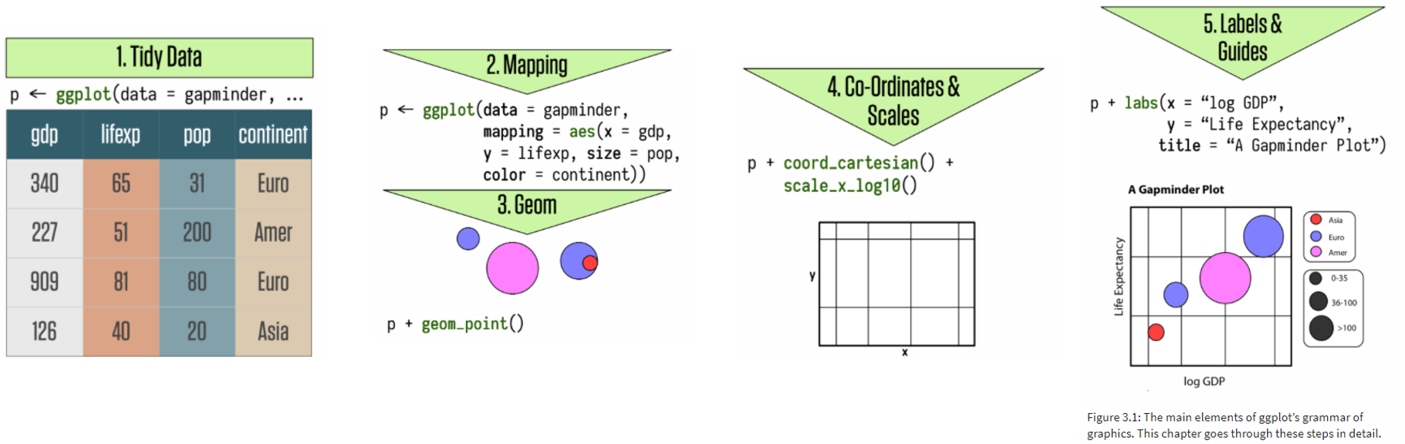
The Grammar of Graphics
The basis of ggplot2
Build plots in layers:
Data to be visualized
Aesthetic mappings
Geometric objects
Statistical transformations
Coordinates
Scales
Facets
(Wickham, 2010, p. 8; Healy, 2019, p. 56)
Notes:
ggplot2 is built as a grammar of graphics. The gg stands for grammar of graphics and forms the basis of the methodology in ggplot2. The idea is to build plots up layer by layer and specify the different pieces of plot as you go. Starting with the data to be visualized, the user defines aesthetic mappings that define how the data will be mapped to plot elements, such as x and y. Then geometric objects are added on to define how those plot elements will be displayed, for example as points or lines. It is possible to make statistical transformations of the data when it is plotted, although we won’t be covering that in this webinar. The coordinate system can be defined in ggplot2 as well as the scales that are used on the axes and colors. Faceting allows small multiple plots to be developed that show plots by groups. Finally, labels and legends can be added and customized.
Source: http://vita.had.co.nz/papers/layered-grammar.pdf
Source: Healy, K. (2019). Data visualization: A practical introduction. Princeton ; Oxford: Princeton University Press

Slide 14
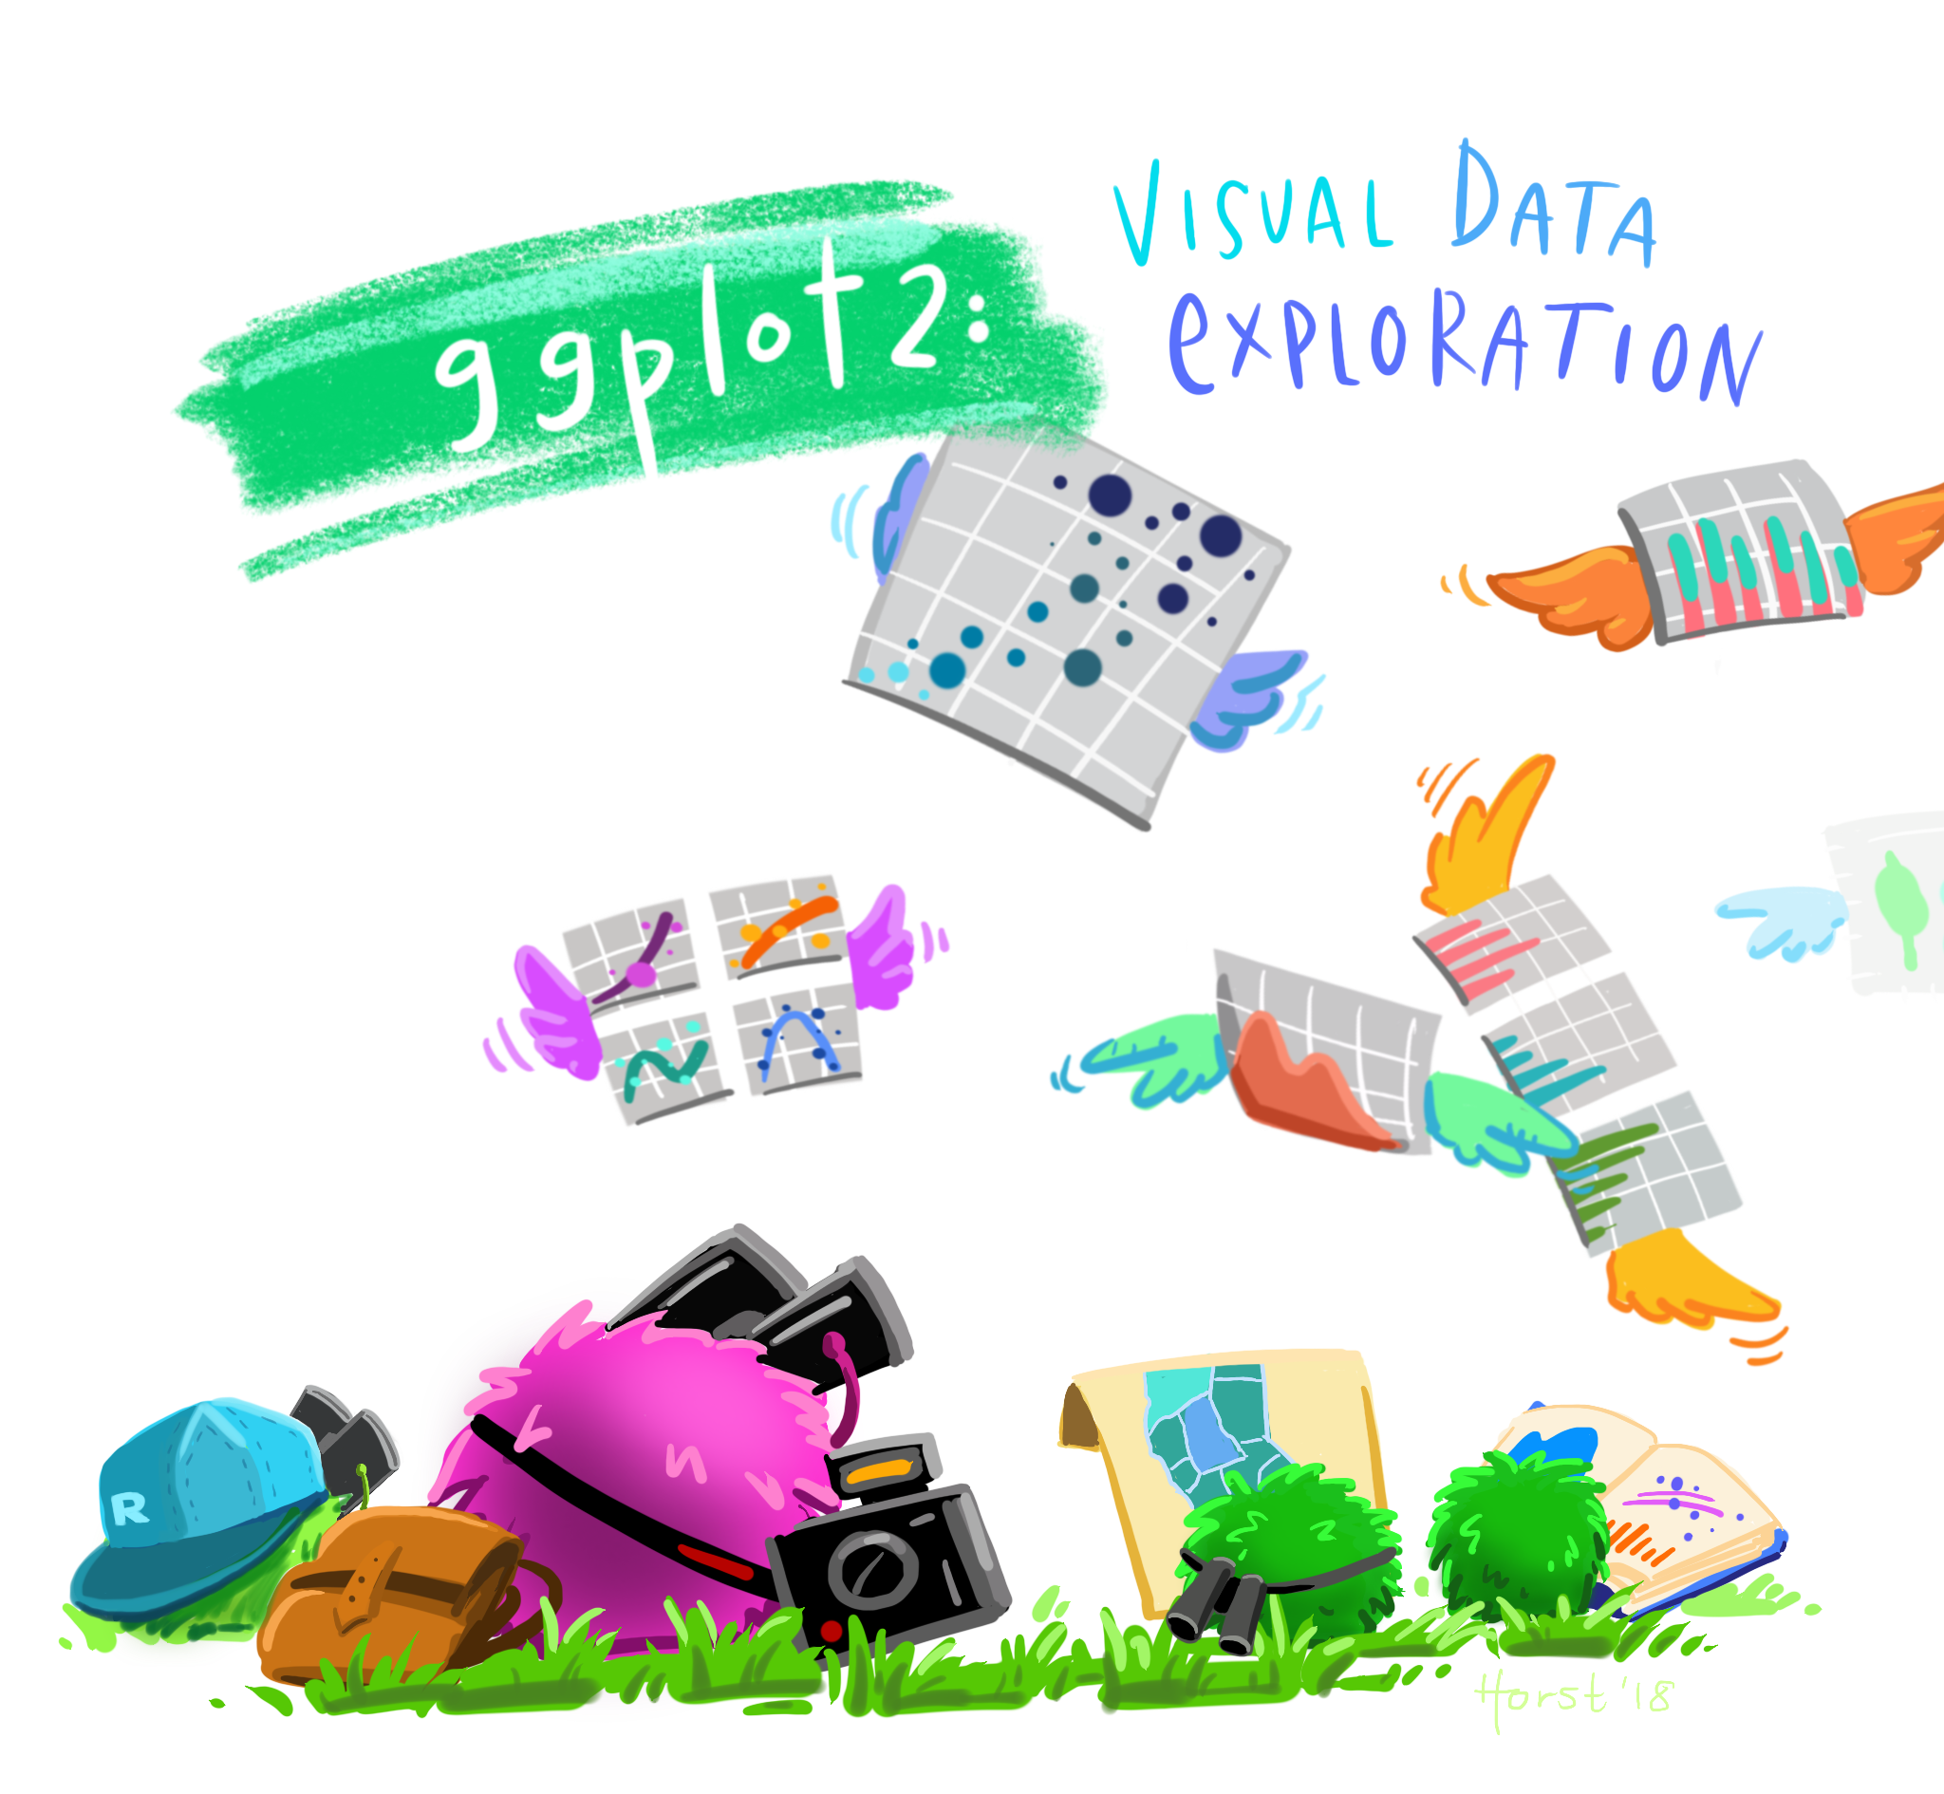
Artwork by @allison_horst
Notes:
ggplot2 can be used to complete visual data exploration. Once you get the hang of it, it’s very easy to quickly generate rough plots to explore your data.

Slide 15
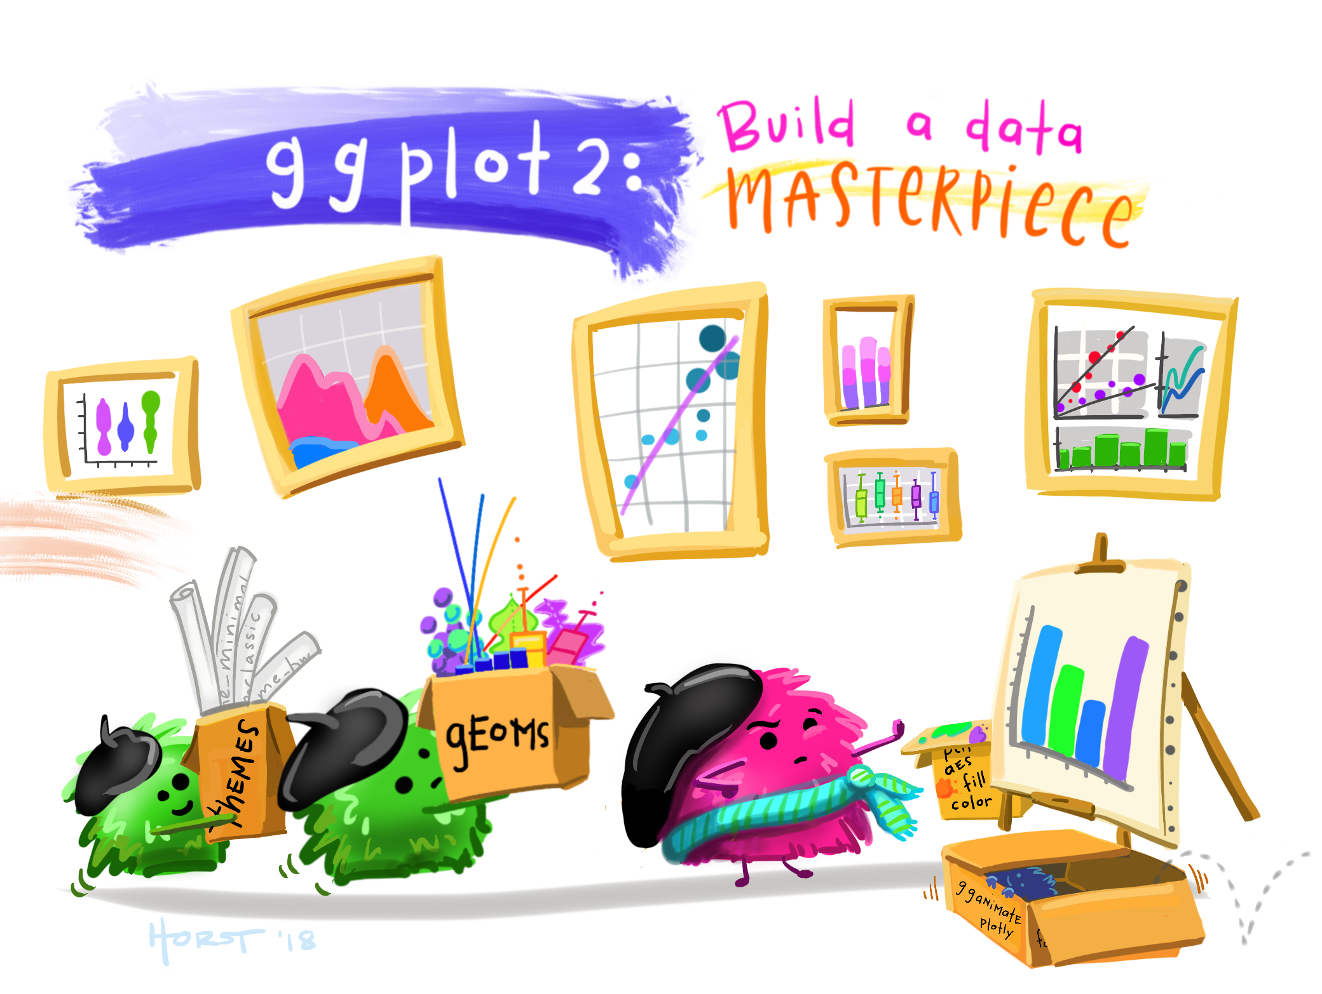
Artwork by @allison_horst
Notes:
ggplot2 can also be used to create well designed and engage data visualizations and infographics. It’s flexibility allows for almost endless customization.

Slide 16
R Setup
R Markdown
tidyverse package
Tidy data
Notes:
To get set up in R, all you will need is the tidyverse package installed and a set of tidy data.

Slide 17
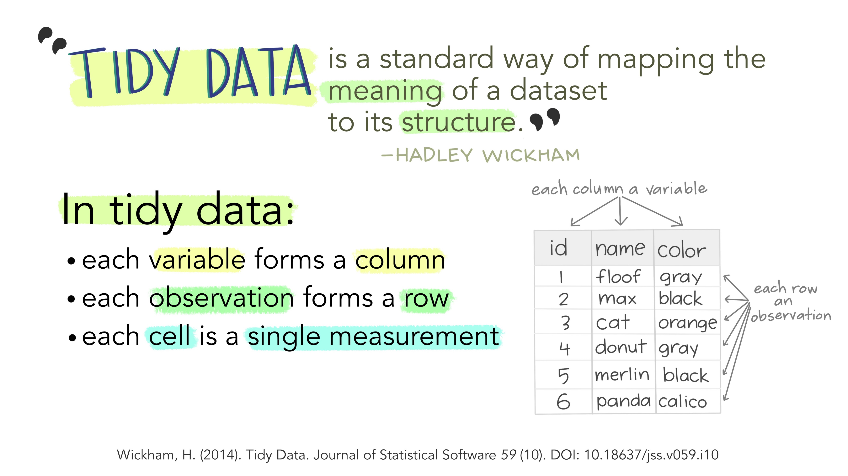
Illustrations from the Openscapes blog Tidy Data for reproducibility, efficiency, and collaboration by Julia Lowndes and Allison Horst
Notes:
Tidy data is a structure of data in which each variable is a column, each observation is a row, and each cell is a single measurement.

Slide 18
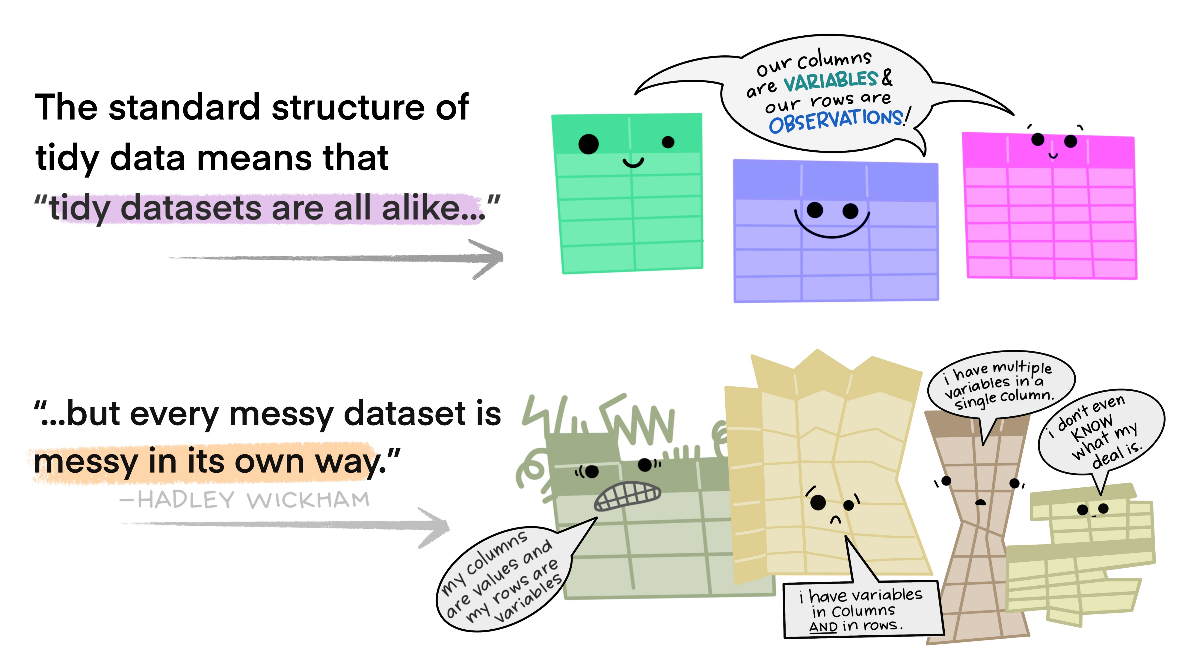
Illustrations from the Openscapes blog Tidy Data for reproducibility, efficiency, and collaboration by Julia Lowndes and Allison Horst
Notes:
Tidy data is useful because multiple datasets in a tidy format are alike.

Slide 19
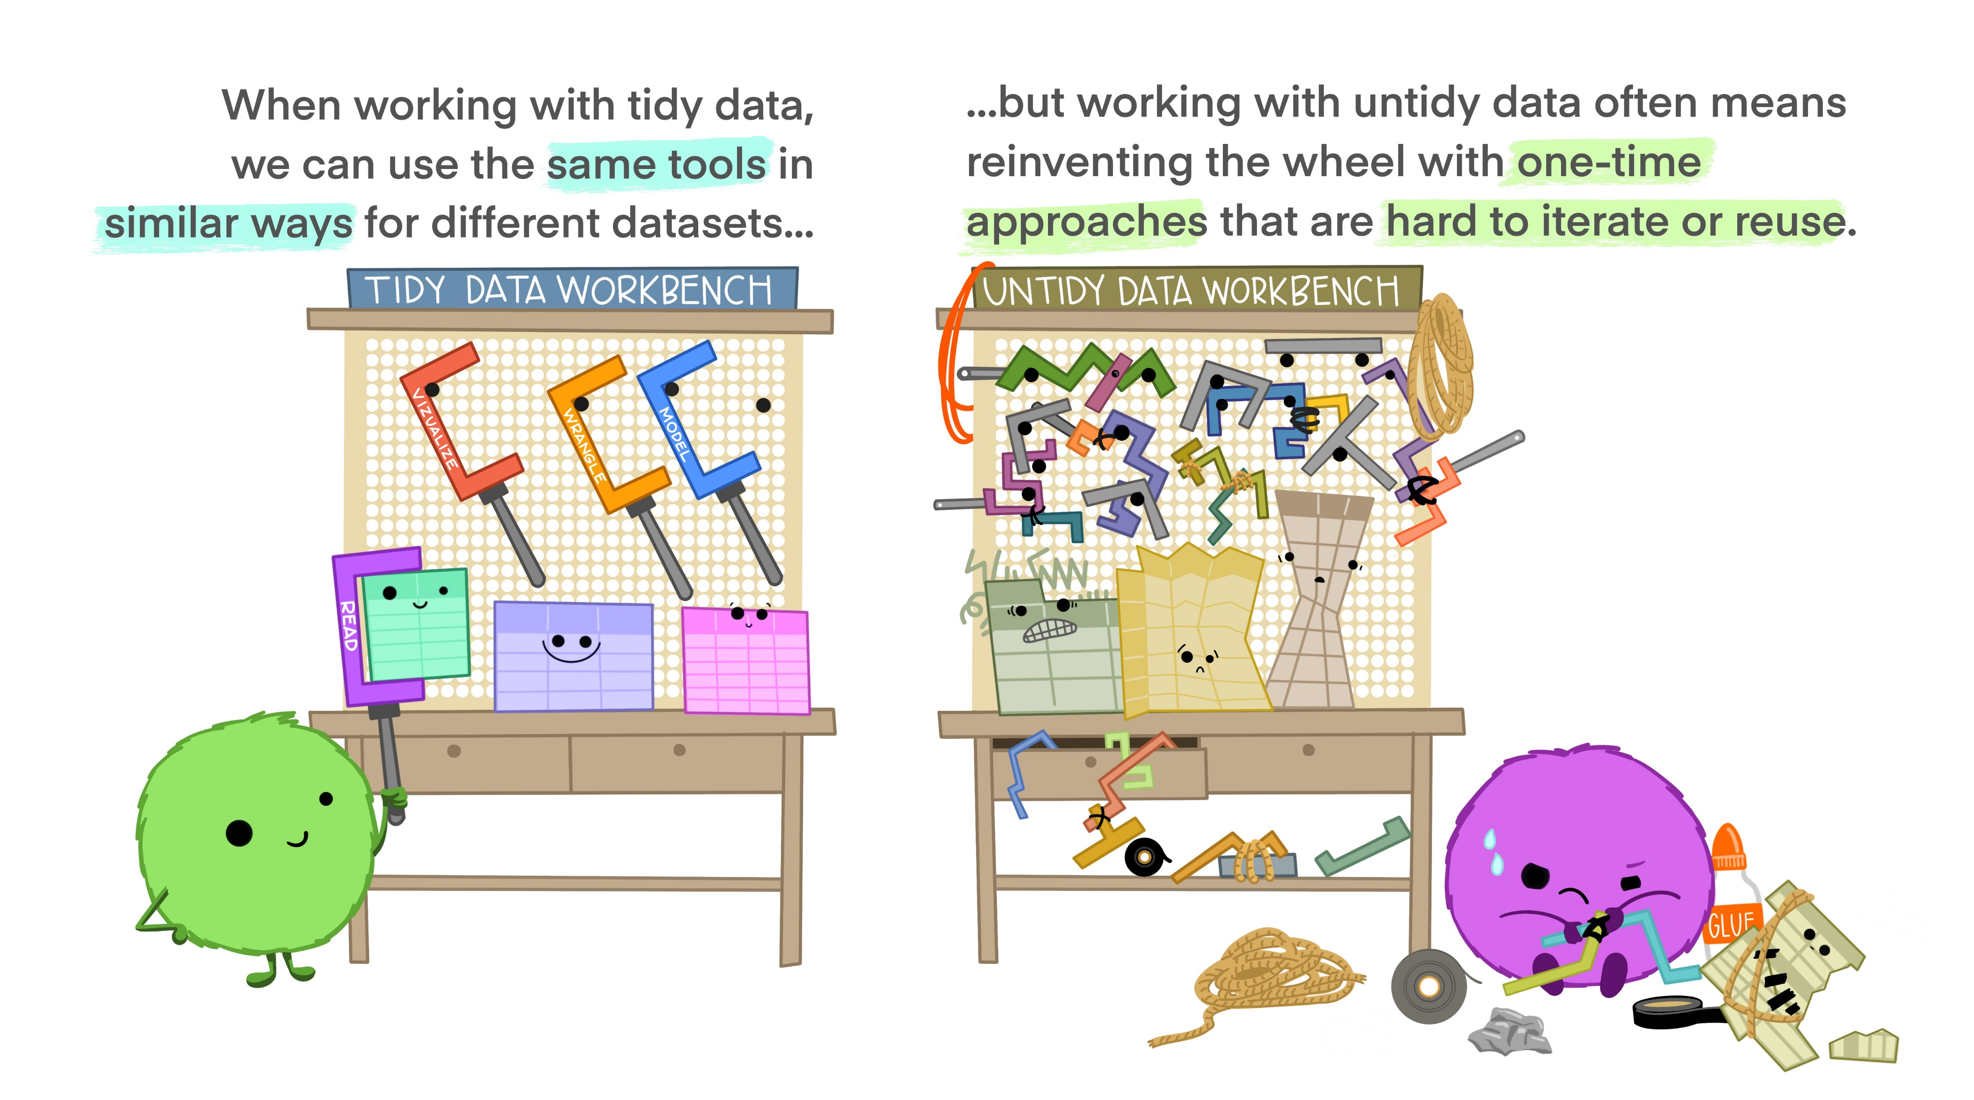
Illustrations from the Openscapes blog Tidy Data for reproducibility, efficiency, and collaboration by Julia Lowndes and Allison Horst
Notes:
This means that the same tools can be used in similar ways on tidy data sets, which is very useful. ggplot2 is easiest to use on tidy data.

Slide 20
Data
IPEDS
Directory
Completions
Enrollment
Admissions
2017-2019
16 Institutions
Reformatted to be tidy
Notes:
The data we will be using for this webinar is from IPEDS. I used data from the directory to get information about the institutions. Then I pulled completions, enrollment, and admissions data for the past 3 survey years. I limited it down to 16 institutions. Since I work at the University of Arizona, I used my institution and our Arizona Board of Regents defined peer group. There was quite a bit of data processing necessary to recode some of the values to their descriptive values and reformat the data into a tidy format.

Slide 21
Plotting in R

Slide 22
Scatterplots

Slide 23
Line Graphs

Slide 24
What did we learn today?
Basic principles of data visualization
Motivation for using ggplot2
How to get started with ggplot2
How to make a scatterplot in R
How to make a line graph in R

Slide 25
Questions

Slide 26
Data Visualization in R
Jenn Schilling
April 13, 2021

Slide 27
Day 2 Agenda
Recap of previous session
How to make a bar graph in R
Adding and changing titles and labels in R
Formatting options for plots in R
How to save a plot in R
Where to go from here
Questions

Slide 28
Learning Outcomes
Explain how the grammar of graphics works in R
Create three different plots in R
Add titles and labels to a plot in R
Change the formatting of a plot in R

Slide 29
Quick Recap
Grammar of graphics
R setup
Making a plot

Slide 30
Bar Graphs

Slide 31
Titles and Labels

Slide 32
Formatting

Slide 33
Saving

Slide 34
Where to go next
ggplot2: Elegant Graphics for Data Analysis by Hadley Wickham
Data Visualization Chapter in R for Data Science by Hadley Wickham & Garrett Grolemund
ggplot2 Reference Guide

Slide 35
What did we learn today?
How to make a bar graph in R
How to make add titles and labels to a graph in R
How to change the formatting of a graph in R
How to save a graph in R
Where to find more information on ggplot2

Slide 36
Questions

